Slide 1
Corona Finder
06.06.2021
Sunday
Emre GÖL – B1605.090027
Kaan Berke – B1605.090049

Slide 2
What is Corona Finder?
Basically, Corona Finder has been created to find out whether owner of the X-ray is infected or not.

Slide 3
Platforms
Web Application
Mobile Application

Slide 4
1. Web Application
Web application of Corona Finder has been created by using FastAPI framework of Python for backend, React framework of JavaScript for frontend and Tensorflow framework of Python for artificial intelligence.

Slide 5
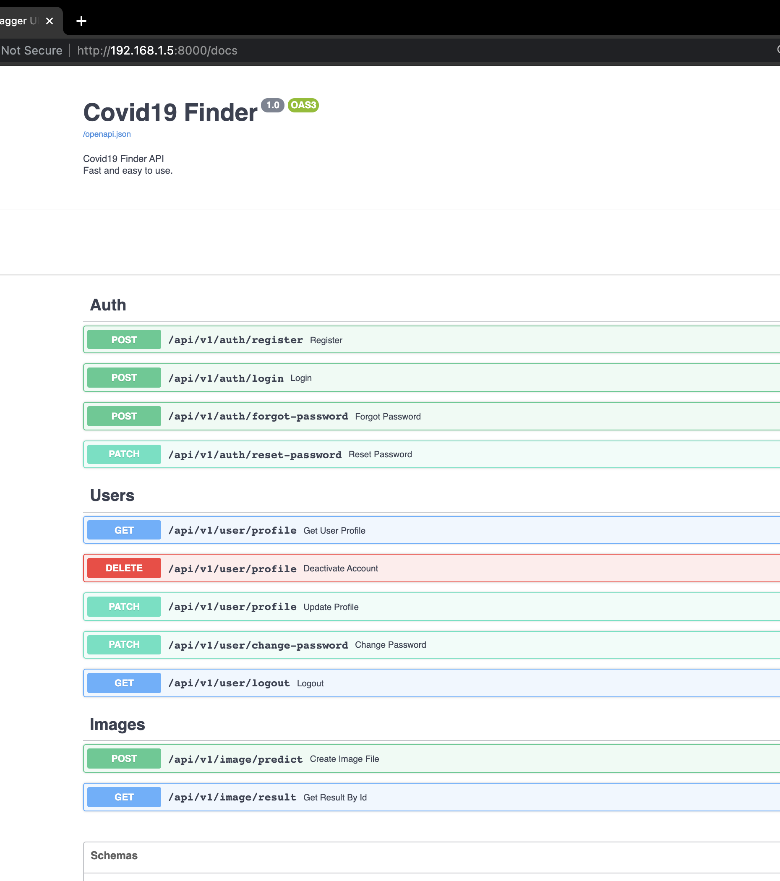
1. Web Application
Back-end endpoints

Slide 6

1. Web Application
Front-end main page

Slide 7
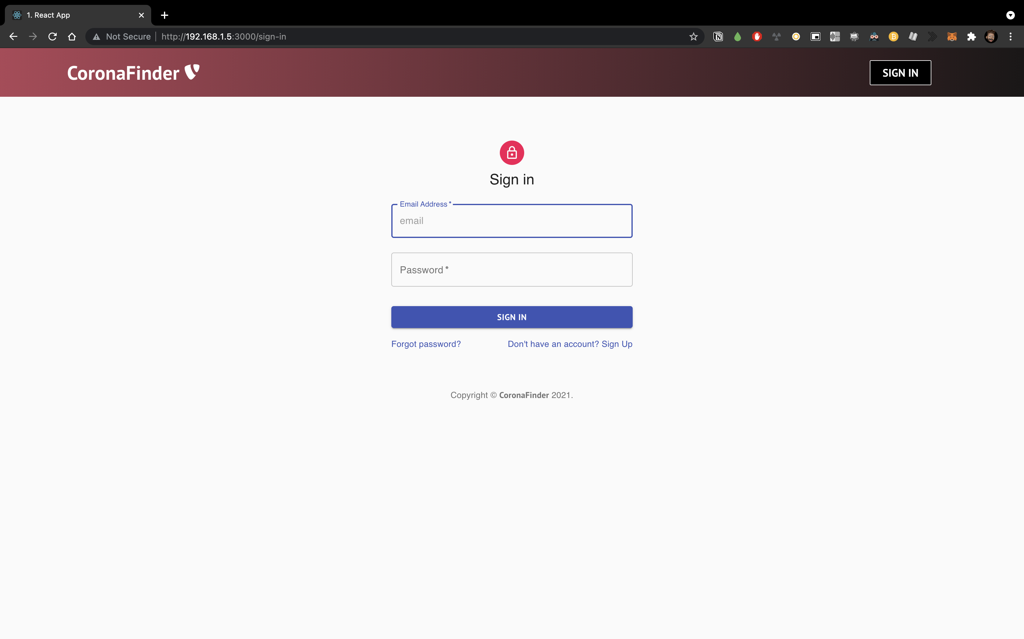
1. Web Application
Front-end sign in page

Slide 8
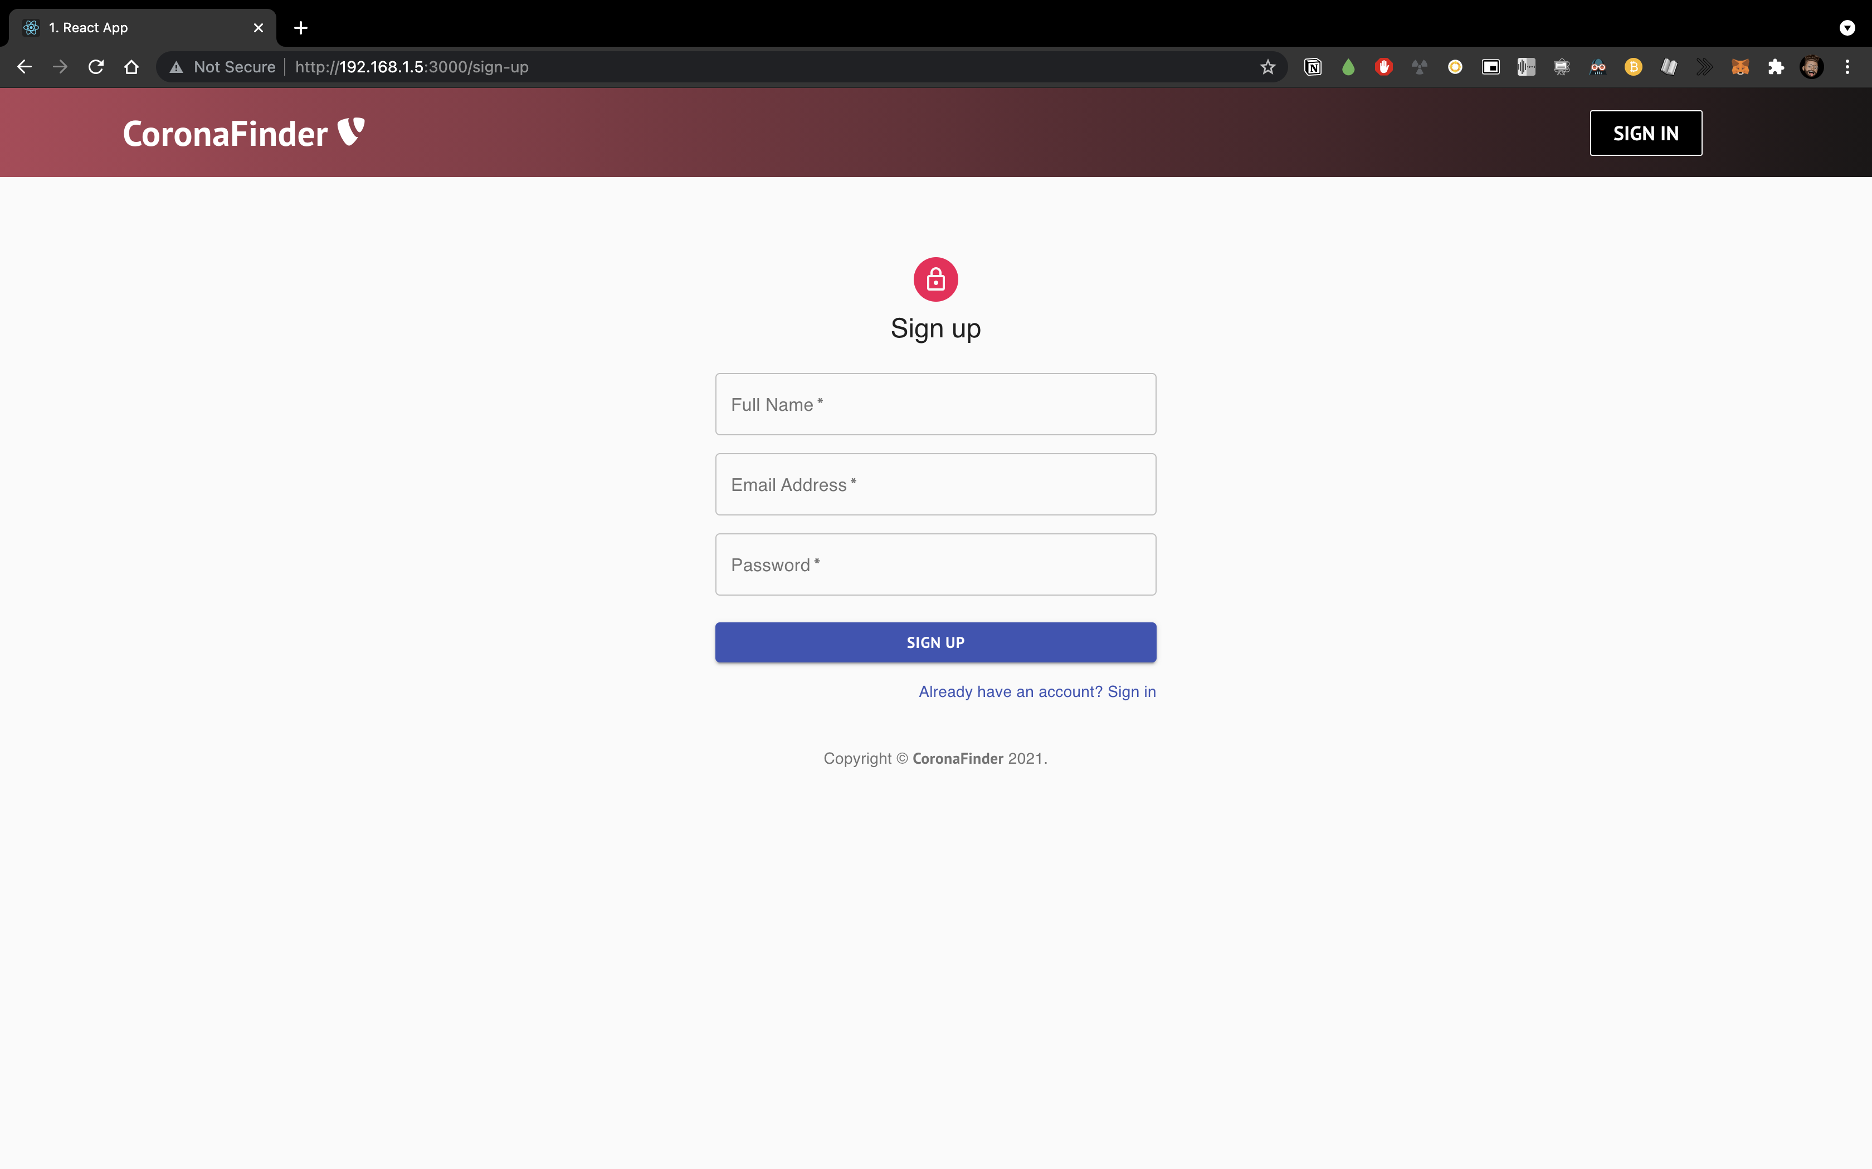
1. Web Application
Front-end sign up page

Slide 9
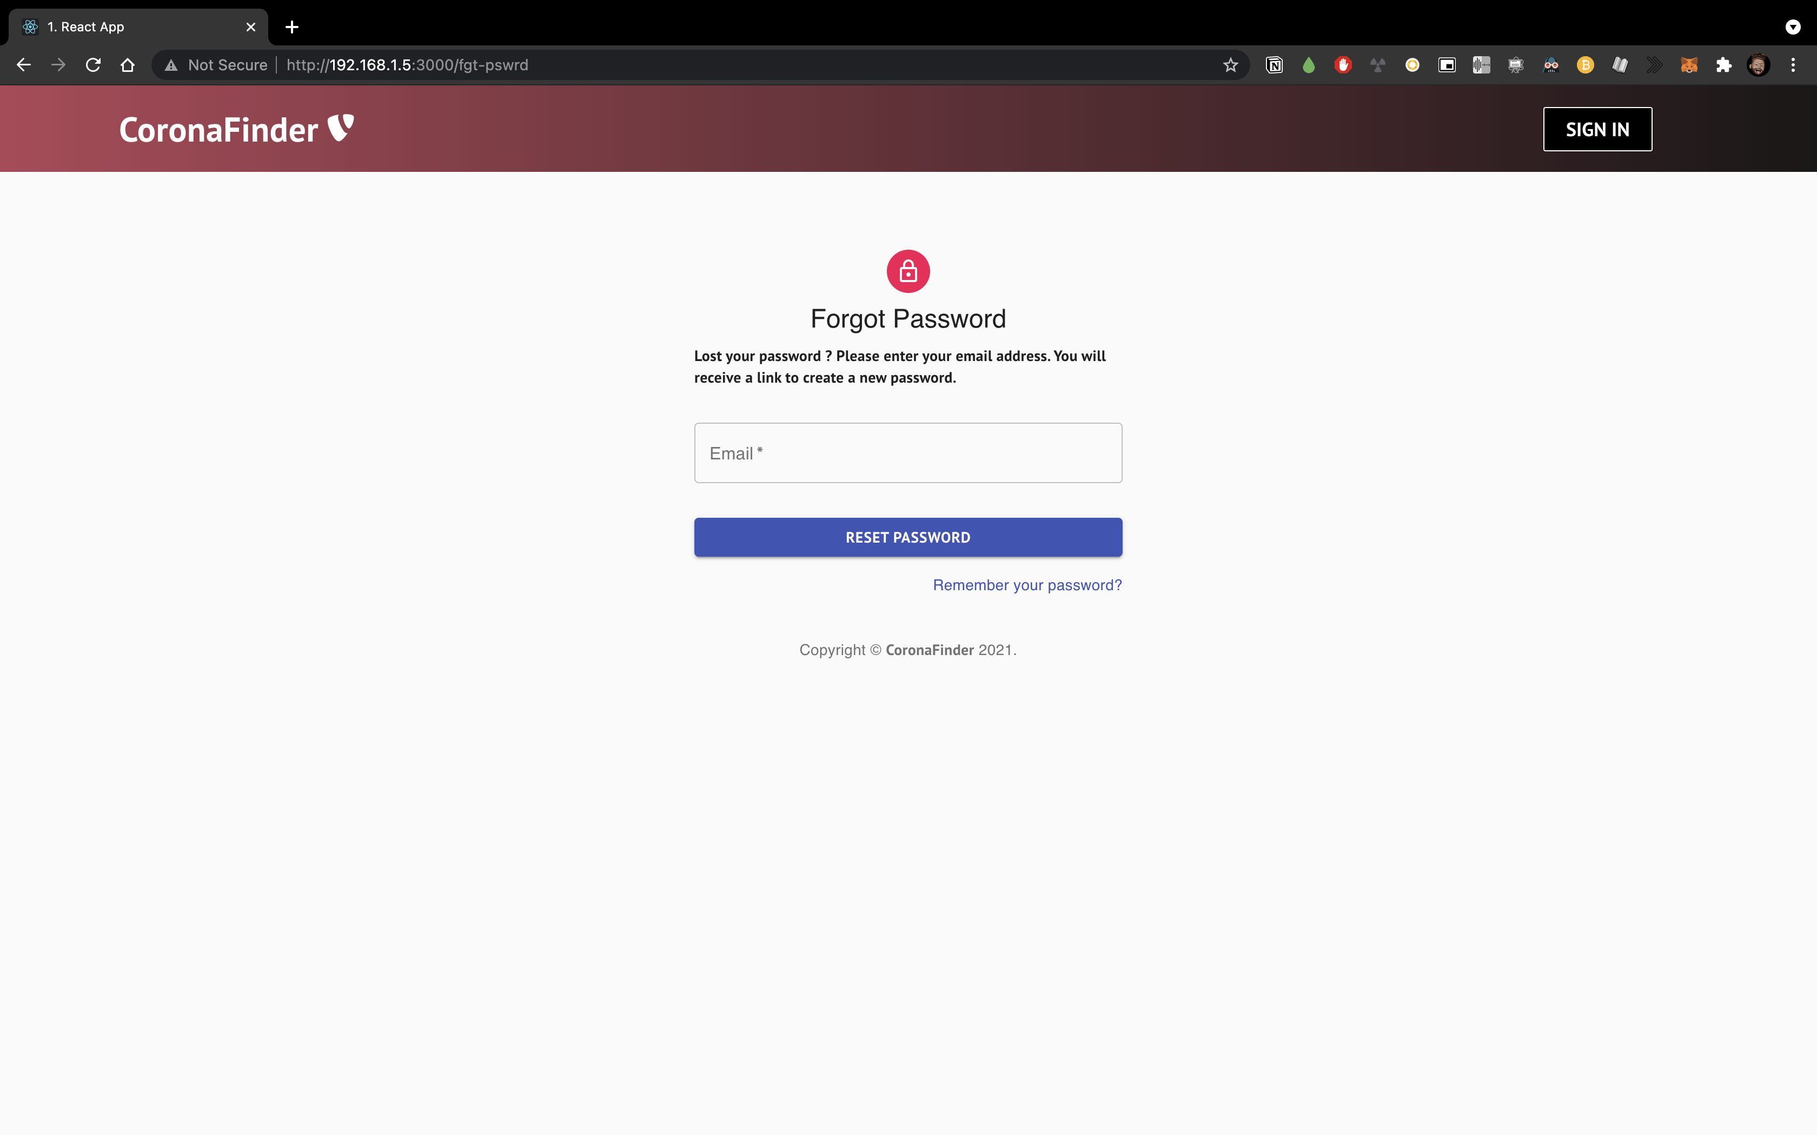
1. Web Application
Front-end forgot password page

Slide 10
2. Mobile Application
Mobile application of Corona Finder has been created by using Java for Android application.

Slide 11

2. Mobile Application
Main page of Corona Finder mobile application

Slide 12

2. Mobile Application
Register functionality of the main page of Corona Finder mobile application

Slide 13

2. Mobile Application
Image upload page of Corona Finder mobile application

Slide 14
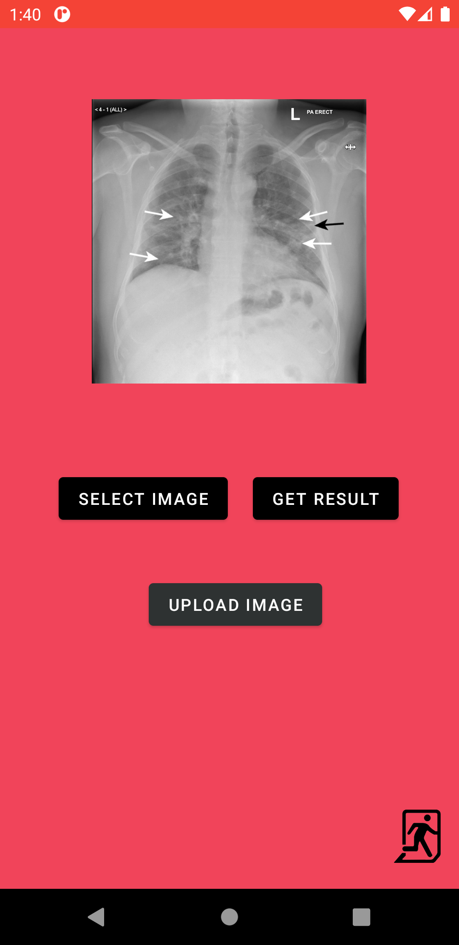
2. Mobile Application
Image has been uploaded by the user. Hence “UPLOAD IMAGE” functionality was activated.

Slide 15
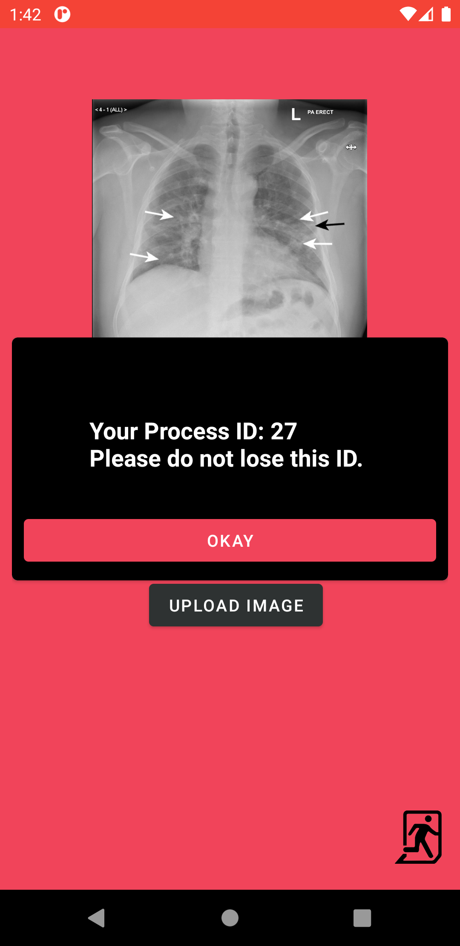
2. Mobile Application
Image has been uploaded successfully and process id, which is belong to the gotten image, was given to user.

Slide 16
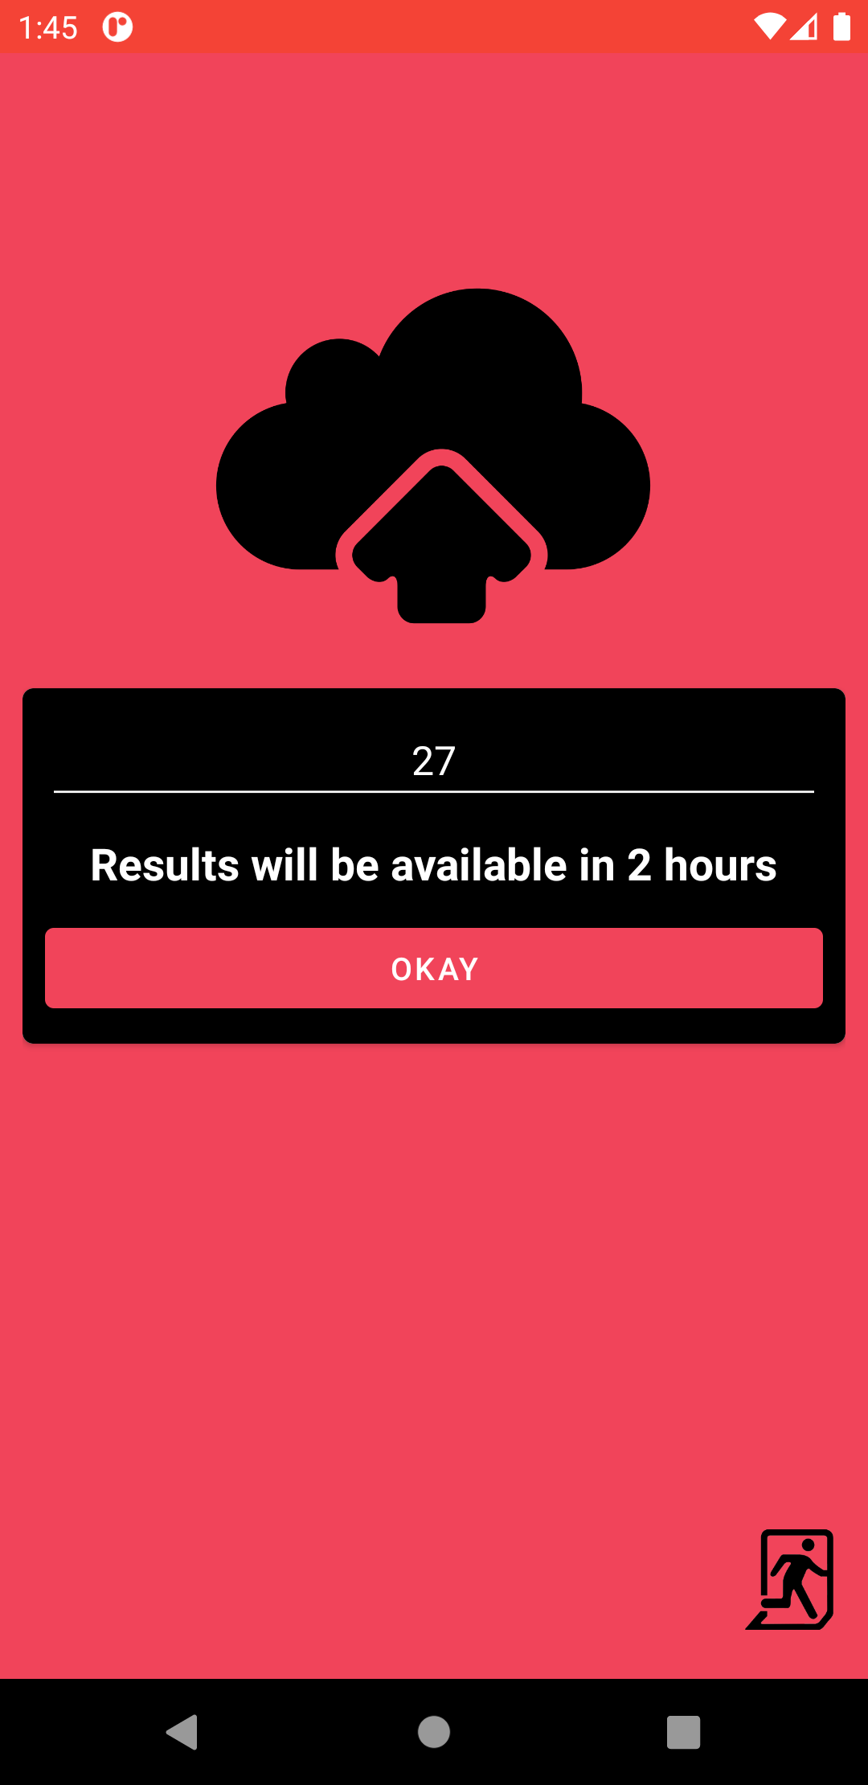
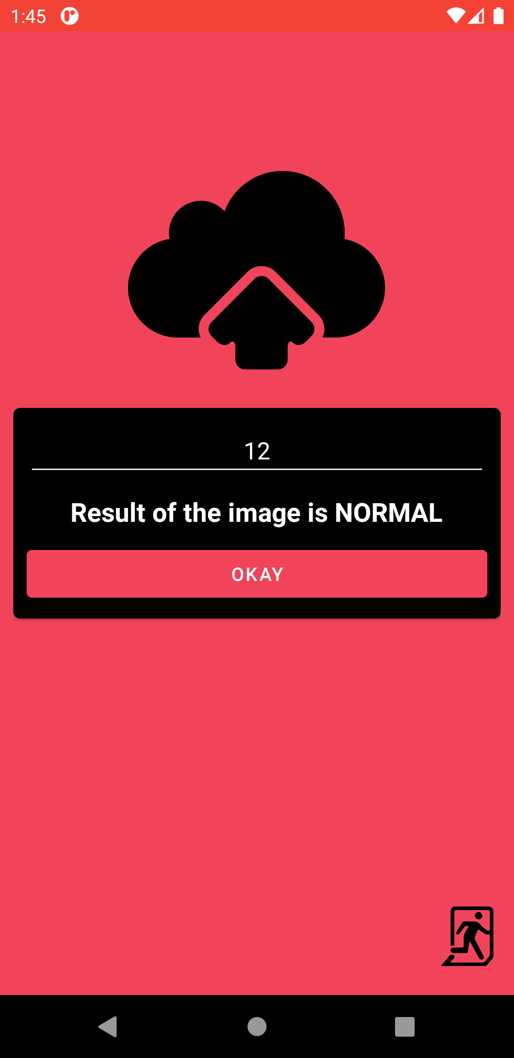
2. Mobile Application
Results can be checked at any time by the provided process id. It takes exactly 2 hours to find out the result.

Slide 17
Artificial Intelligence
Tensorflow framework of Python language was used as main tool.
Dataset was collected from various resources.
Many architectures were tried.
There was not a computer with a powerful GPU and it consumed too much time.
Transfer learning was the best option among all of them.

Slide 18
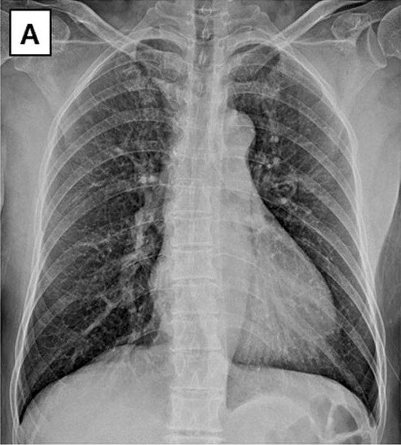
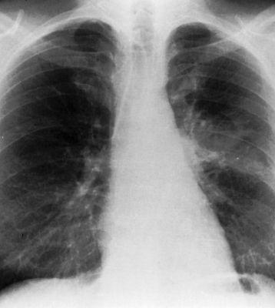
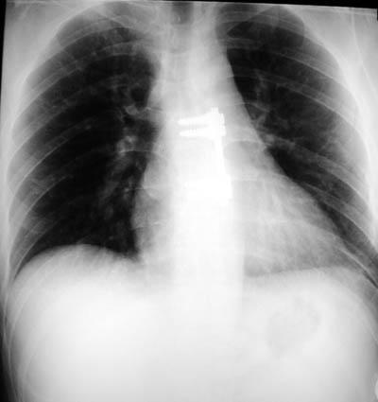
Artificial Intelligence Dataset
COVID
PNEUMONIA
NORMAL
Sample - I

Slide 19
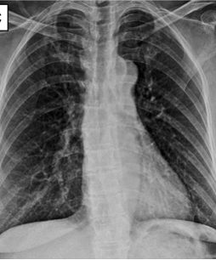
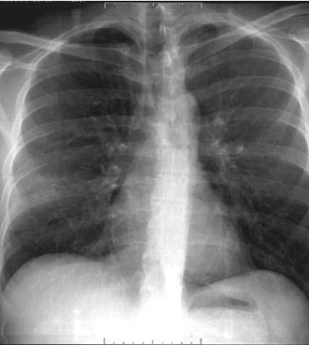
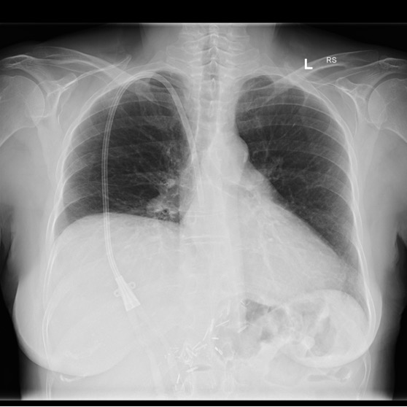
Artificial Intelligence Dataset
COVID
PNEUMONIA
NORMAL
Sample - II

Slide 20
Artificial Intelligence Model Architecture
Model: "model"
_________________________________________________________________
Layer (type) Output Shape Param #
=================================================================
input_1 (InputLayer) [(None, 224, 224, 3)] 0
_________________________________________________________________
block1_conv1 (Conv2D) (None, 224, 224, 64) 1792
_________________________________________________________________
block1_conv2 (Conv2D) (None, 224, 224, 64) 36928
_________________________________________________________________
block1_pool (MaxPooling2D) (None, 112, 112, 64) 0
_________________________________________________________________
block2_conv1 (Conv2D) (None, 112, 112, 128) 73856
_________________________________________________________________
block2_conv2 (Conv2D) (None, 112, 112, 128) 147584
_________________________________________________________________
block2_pool (MaxPooling2D) (None, 56, 56, 128) 0
_________________________________________________________________
block3_conv1 (Conv2D) (None, 56, 56, 256) 295168
_________________________________________________________________
block3_conv2 (Conv2D) (None, 56, 56, 256) 590080
_________________________________________________________________
block3_conv3 (Conv2D) (None, 56, 56, 256) 590080
_________________________________________________________________
block3_pool (MaxPooling2D) (None, 28, 28, 256) 0
_________________________________________________________________
block4_conv1 (Conv2D) (None, 28, 28, 512) 1180160
_________________________________________________________________
block4_conv2 (Conv2D) (None, 28, 28, 512) 2359808
_________________________________________________________________
block4_conv3 (Conv2D) (None, 28, 28, 512) 2359808
_________________________________________________________________
block4_pool (MaxPooling2D) (None, 14, 14, 512) 0
_________________________________________________________________
block5_conv1 (Conv2D) (None, 14, 14, 512) 2359808
_________________________________________________________________
block5_conv2 (Conv2D) (None, 14, 14, 512) 2359808
_________________________________________________________________
block5_conv3 (Conv2D) (None, 14, 14, 512) 2359808
_________________________________________________________________
block5_pool (MaxPooling2D) (None, 7, 7, 512) 0
_________________________________________________________________
conv2d (Conv2D) (None, 7, 7, 128) 589952
_________________________________________________________________
batch_normalization (BatchNo (None, 7, 7, 128) 512
_________________________________________________________________
activation (Activation) (None, 7, 7, 128) 0
_________________________________________________________________
max_pooling2d (MaxPooling2D) (None, 3, 3, 128) 0
_________________________________________________________________
dropout (Dropout) (None, 3, 3, 128) 0
_________________________________________________________________
conv2d_1 (Conv2D) (None, 3, 3, 256) 295168
_________________________________________________________________
batch_normalization_1 (Batch (None, 3, 3, 256) 1024
_________________________________________________________________
activation_1 (Activation) (None, 3, 3, 256) 0
_________________________________________________________________
max_pooling2d_1 (MaxPooling2 (None, 1, 1, 256) 0
_________________________________________________________________
dropout_1 (Dropout) (None, 1, 1, 256) 0
_________________________________________________________________
flatten (Flatten) (None, 256) 0
_________________________________________________________________
dense (Dense) (None, 32) 8224
_________________________________________________________________
dropout_2 (Dropout) (None, 32) 0
_________________________________________________________________
dense_1 (Dense) (None, 3) 99
=================================================================
Total params: 15,609,667
Trainable params: 894,211
Non-trainable params: 14,715,456
_________________________________________________________________

Slide 21
Artificial Intelligence Hyperparameters
Optimizer: Stochastic Gradient Descent ( SGD )
Loss: Categorical Cross Entropy

Slide 22
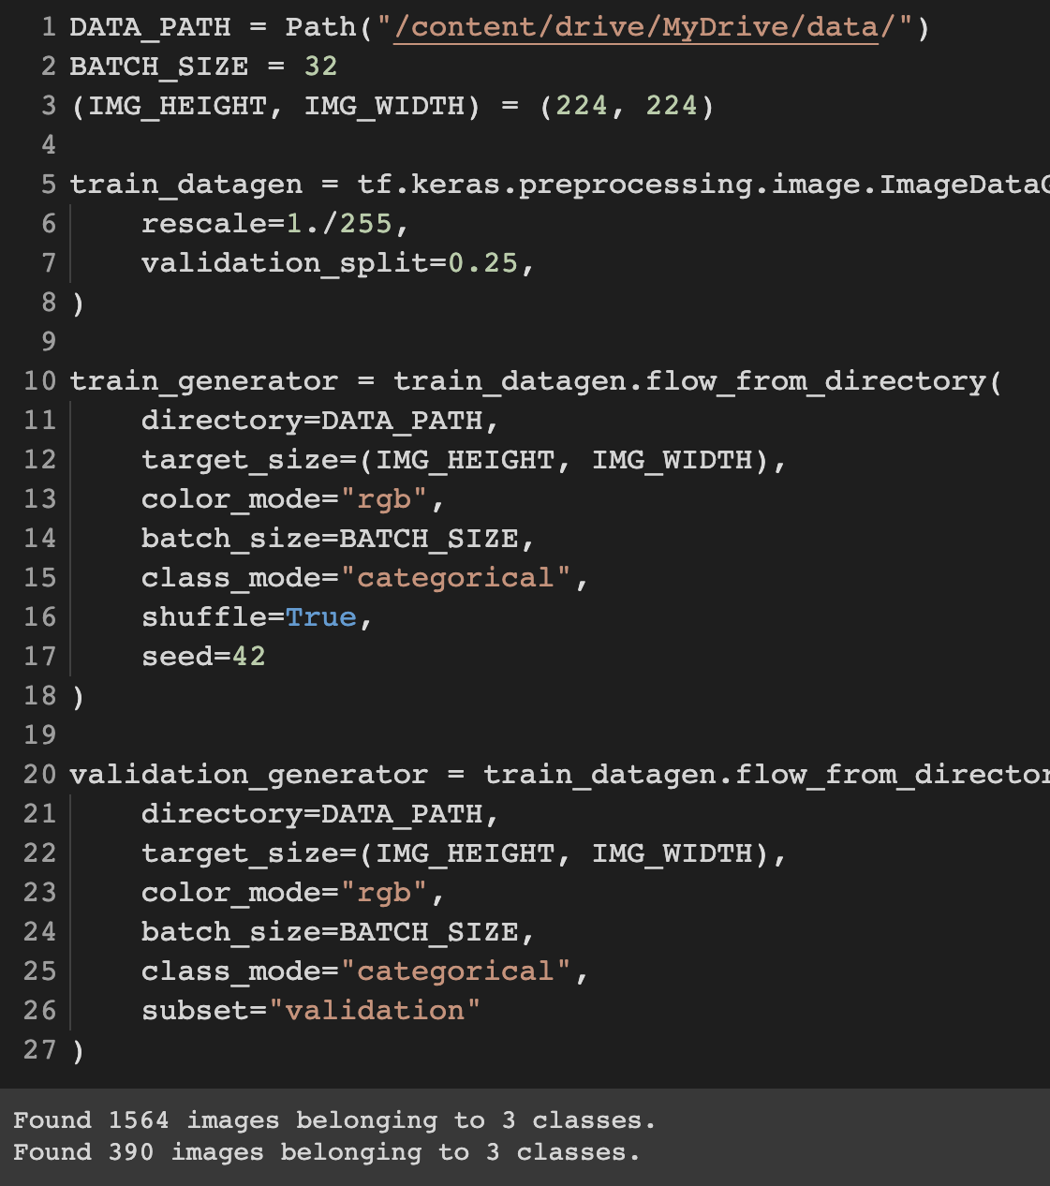
Artificial Intelligence Validation Set
Model was evaluated by the validation part of the dataset. It was split by 1/4.

Slide 23
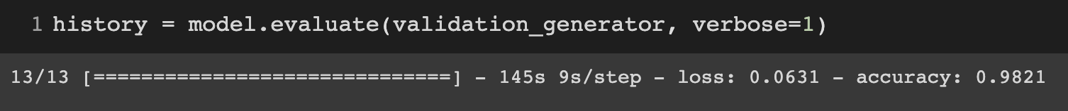
Artificial Intelligence Evaluation

Slide 24
THANK YOU FOR LISTENING

